Slide 1
Central Retinal Vein Occlusion
Dr. SEA Bunseng
First Year Resident

Slide 2
Outline
Introduction
Epidemiology
Pathophysiology
Etiology
Risk Factors
Diagnosis
Complications
Management
Prognosis

Slide 3
I. Introduction
A common retinal vascular disorder.
Over 90% of cases occur in patients over the age of 55 years.
Painless loss of vision
Two clinical types:
Ischemic CRVO (I-CRVO)
Non-ischemic CRVO (NI-CRVO)

Slide 4
Epidemiology
A large population-based study in Israel reported a 4-year incidence of retinal vein occlusion of 2.14 cases per 1000 of general population older than 40 years and 5.36 cases per 1000 of general population older than 64 years.
In Australia, the prevalence of vein occlusion ranges from 0.7% in patients aged 49-60 years to 4.6% in patients older than 80 years ª.
In USA, In a recent publication, the Beaver Dam Eye Study Group reported the 15-year cumulative incidence of CRVO to be 0.5% ^{b}.
CRVO occurs slightly more frequently in males than in females.
More than 90% of CRVO occurs in patients older than 50 years, but it has been reported in all age groups.
Mitchell P, Smith W, Chang A. Prevalence and associations of retinal vein occlusion in Australia. The Blue Mountains Eye Study. Arch Ophthalmol. Oct 1996;114(10):1243-7.
Klein R, Moss SE, Meuer SM, et al. The 15-year cumulative incidence of retinal vein occlusion: the Beaver Dam Eye Study. Arch Ophthalmol. Apr 2008;126(4):513-8.

Slide 5
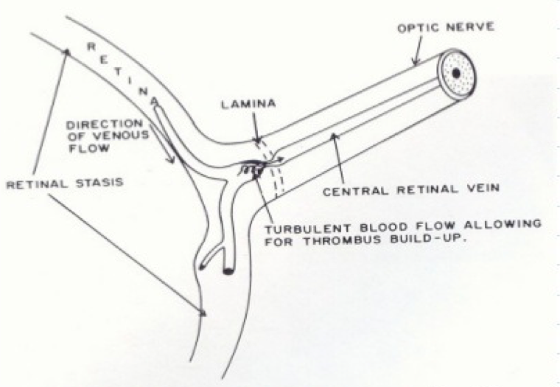
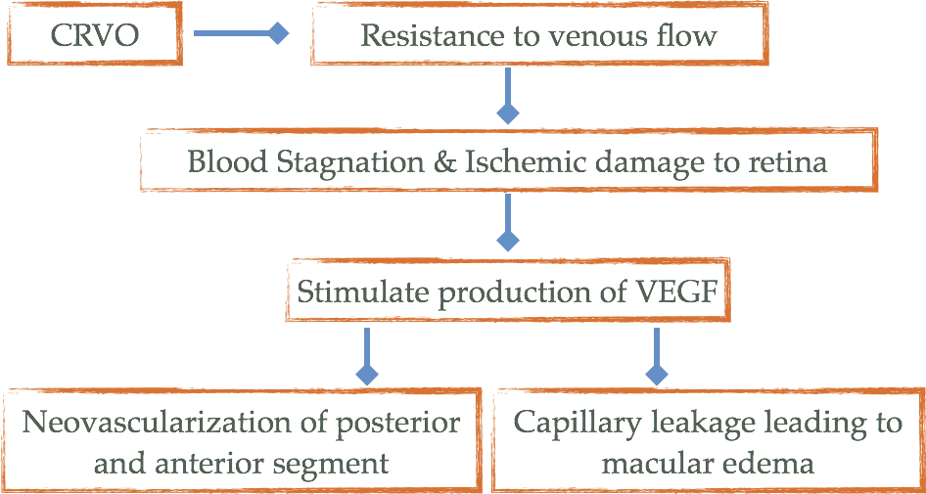
Pathophysiology
Notes:
The central retinal artery and vein share a common adventitial sheath as they exit the optic nerve head and pass through a narrow opening in the lamina cribrosa. this narrow entry in the lamina cribrosa, the vessels are in a tight compartment with limited space for displacement. This anatomical position predisposes to thrombus formation in the central retinal vein by various factors, including slowing of the blood stream, changes in the vessel wall, and changes in the blood.

Slide 6
Etiology
Atherosclerosis
Hypertension
Optic disc edema
Glaucoma
Hypercoagulable state: Polycythemia, multiple myeloma etc
Vasculitis: SLE, sarcoidosis, syphilis etc
Drugs: Oral contraceptives, diuretics, and others.
Abnormal platelet function
Orbital diseases: Thyroid eye disease, orbital tumours etc

Slide 7
Risk Factors
Age
Hypertention
Hyperlipidaemia
DM
Raised IOP
Smokingª
R Klein, B E Klein, S E Moss, and S M Meuer. The epidemiology of retinal vein occlusion: the Beaver Dam Eye Study. Trans Am Ophthalmol Soc. 2000; 98: 133–143.

Slide 8
Diagnosis
History
^{Symptoms}
Painless loss of vision (mild to severe)
^{Usually unilateral}
^{Past & Personal history}
Present any risk factors (HTN, DM, Smoking, Hyperlipidemia, Bleeding or clotting disorder, Glaucoma, Oral contraceptive use, Head trauma)

Slide 9
Diagnosis continues
Slit Lamp Examination
VA & BCVA
Pupillary reactions
IOP
EOM
Cornea
AC angle
Iris

Slide 10
Diagnosis continues
Fundus finding
Diffuse retinal flame shaped hemorrhages in all 4 quadrants; dilated, tortuous retinal veins
Extensive hemorrhage- blood and thunder appearance
cotton wool spots
macular edema
Optic disc (Edema/optociliary collateral vessels/atrophy)
Neovessels (NVD, NVE, NVI)

Slide 11
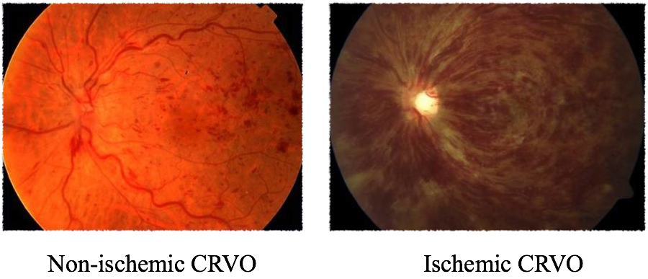
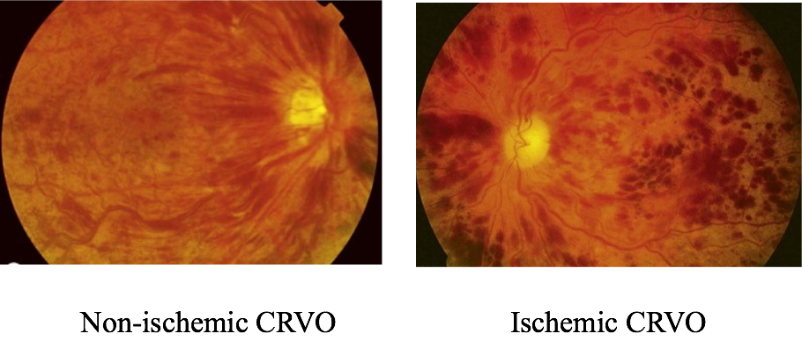

Slide 12
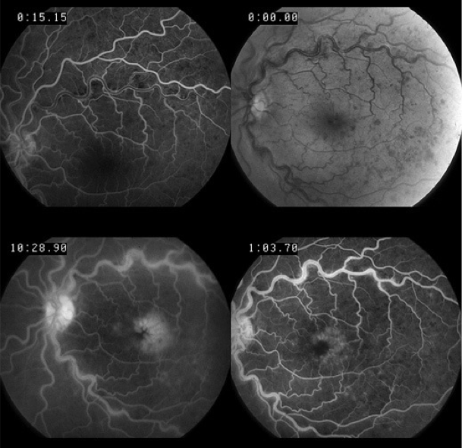
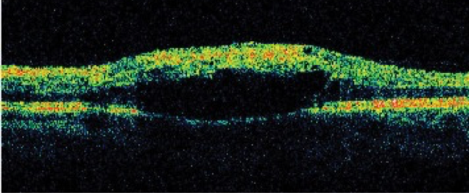
Diagnosis continues
Ocular Investigation
FFA (Fundus Fluorescein Angiography)
ERG (Electroretinogram)
OCT (Optical Coherence Tomography)
Notes:
FFA: In NI-CRVO: show delayed arteriovenous transit time, blockage by haemorrhages, good retinal capillary perfusion and late leakage
In I-CRVO: show marked delay in arteriovenous transit time, which is longer than 20s, central masking by retinal haemorrhage, extensive areas of capillary non-perfusion and vessel wall staining. Greater than 10 disc areas of retinal capillary non-perfusion is associated with an increased risk of neovascularization.

Slide 13
Systemic Investigation
Diagnosis continues
All Patients
CBC & ESR
Renal function tests
Random blood glucose
Lipid profile
Plasma protein electrophoresis
Thyroid function
ECG
According to clinical indication
Thrombophilia screen
Anticardiolipin antibody
CRP
Serum ACE
Autoantibodies
CXR
Fasting plasma homocystine levels

Slide 14
Complication
Macular edema (ME)
Neovascularization
Vitreous hemorrhage
Optic atrophy

Slide 15
Management
Reduced Risk Factors
Treat underlying medical disorders
Follow up, NI-CRVO after 3 months and I-CRVO monthly for 6 months.

Slide 16
Management of ME
Intravitreal steroid
The SCORE study compare 1 mg and 4 mg IVTA with standard-care treatment for vision loss associated with macular edema secondary to RVO
The SCORE study showed an improvement in the vision of 3 or more lines at one year in over 25% of patients treated with an average of 2 injections of 1 mg triamcinolone versus 7% of controls.
Notes:
Standard Care Versus Corticosteroid for Retinal Vein Occlusion (SCORE): Between nov 2004-feb 2008,1200 patients with CRVO were enrolled in the SCORE study, which was designed to compare 1 mg and 4 mg IVTA with standard-care treatment for vision loss associated with macular edema secondary to RVO.
Patients will be followed for up to 3 years to measure long-term treatment efficacy and safety; reinjections (if needed) will be performed beginning at 4 months after the initial therapy.

Slide 17
Management of ME
Intravitreal steroid
Dexamethasone is a potent, water-soluble corticosteroid that can be delivered to the vitreous cavity by the dexamethasone intravitreal implant. A DEX implant is composed of a biodegradable copolymer of lactic acid and glycolic acid-containing micronized dexamethasone.
The drug–copolymer complex gradually releases the total dose of dexamethasone over a series of months after insertion into the eye through a small pars plana puncture using a customized applicator system
A trial (GENEVA) of a 0.7 mg dexamethasone sustained-released biodegradable intravitreal implant (OzurdexR) showed substantial visual improvement over the first 2 months following a single implantation, though this declined to baseline by 6 months.
Notes:
Wills Eye Institute, Philadelphia, Pennsylvania 19107, USA.
Design: Two identical, multicenter, masked, randomized, 6 months, sham-controlled clinical
Participants: A total of 1267 patients with vision loss due to ME associated with CRVO
Intervention: A single treatment with DEX implant 0.7 mg (n = 427), DEX implant 0.35 mg (n = 414), or sham (n = 426).
Conclusion: Dexamethasone intravitreal implant can both reduce the risk of vision loss and improve the speed and incidence of visual improvement in eyes with ME secondary to BRVO or CRVO and may be a useful therapeutic option for eyes with these conditions

Slide 18
Management of ME
Intravitreal anti-VEGF agents
Ranibizumab for Macular Edema following Central Retinal Vein Occlusion
Intraocular injections of 0.3 mg or 0.5 mg ranibizumab provided rapid improvement in 6-month visual acuity and macular edema following CRVO, with low rates of ocular and nonocular safety events
Injections were given monthly for 6 months and subsequently less intensively.
Several uncontrolled case caries suggests that approximately 50% of patients improve 2 or more lines with intravitreal bevacizumab, with 90% of eye achieving stabilisation of vision by 12 months.
Notes:
Ranibizumab for Macular Edema following Central Retinal Vein Occlusion
Purpose: To assess the efficacy and safety of intraocular injections of 0.3 mg or 0.5 mg ranibizumab in patients with macular edema after central retinal vein occlusion (CRVO)
Design: Prospective, randomized, sham injection-controlled, double-masked, multicenter clinical trial.
Participants: A total of 392 patients with macular edema after CRVO.
Methods: Eligible patients were randomized 1:1:1 to receive monthly intraocular injections of 0.3 or 0.5 mg of ranibizumab or sham injections.
Main Outcome Measures: The primary efficacy outcome measure was mean change from baseline best-corrected visual acuity (BCVA) letter score at month 6. Secondary outcomes included other parameters of visual function and central foveal thickness (CFT).
Result: The percentage of patients who gained ≥15 letters in BCVA at month 6 was 46.2% (0.3 mg) and 47.7% (0.5 mg) in the ranibizumab groups and 16.9% in the sham group (P<0.0001 for each ranibizumab group vs. shame)
The median percent reduction in excess foveal thickness at month 6 was 94.0% and 97.3% in the 0.3 mg and 0.5 mg groups, respectively, and 23.9% in the sham group
Conclusions: Intraocular injections of 0.3 mg or 0.5 mg ranibizumab provided rapid improvement in 6-month visual acuity and macular edema following CRVO, with low rates of ocular and nonocular safety events.

Slide 19
Management of Neovascularization
Central Vein Occlusion Study (CVOS), provided guidelines for the treatment and follow-up care of patients with CRVO.
CVOS evaluated the efficacy of prophylactic PRP in eyes with 10 or more disc areas of retinal capillary nonperfusion, confirmed by fluorescein angiography, in preventing development of 2 clock hours of iris neovascularization or any angle neovascularization or whether it is more appropriate to apply PRP only when iris neovascularization or any angle neovascularization occurs.
CVOS concluded that prophylactic PRP did not prevent the development of iris neovascularization and recommended to wait for the development of early iris neovascularization and then apply PRP.

Slide 20
Management of Vitreous Hemorrhage
pars plana vitrectomy performed concurrently with intraoperative PRP is the management strategy
Notes:
Argon green laser usually is used. Laser parameters should be about 500-µm size, 0.1-0.2 second duration, and power should be sufficient to give medium white burns. Laser spots are applied around the posterior pole, extending anterior to equator. They should be about 1 burn apart and total 1200-2500 spots.

Slide 21
Prognosis
NI-CRVO, the prognosis is reasonably good with return of vision to normal or near normal in about 50%. The main cause for poor vision is chronic macular oedema, which may lead to secondary RPE changes.
To a certain extent the prognosis is related to initial visual acuity as follows:
6/18 or better, it is likely to remain so
6/24-6/60, the clinical course is variable, and vision may subsequently improve, remain the same, or worsen
Worse than 6/60, improvement is unlikely
I-CRVO, the prognosis is extremely poor due to macular ischaemia. Rubeosis iridis develops in about 50% of eyes, usually between 2 and 4 months (100-day glaucoma), and there is a high risk of neovascular glaucoma. The development of opticociliary shunts may protect the eye from anterior segment neovascularization and probably indicates a dramatic reduction in risk. Retinal neovascularization occurs in about 5% of eyes.

Slide 22
Take-home Message
 | NI-CRVO | I-CRVO
Frequency | 75-80% | 20-25%
VA | Better than 6/60 | Worse than 6/60
RAPD | Slight or nil | Marked
VF defect | rare | Common
Fundus | Less haemorrhages & CW spots, optic disc edema | Severe tortuosity and engorgement of CRV, extensive hemorrhage & CW spots, severe optic disc edema and macular edema
FFA | Good perfusion | Non-perfusion > 10DD
Prognosis | 50%→ 6/60 or better | 60% → Rubeosis & NVG

Slide 23
References
Section 12, Retina and Vitreous. (2012-2013). Singapore, the American Association of Ophthalmology. page: 154-159
Kenski, J. Jack. MD, (2011). Clinical Ophthalmology: A Systemic Approach, 7th Edition. Elsevier Saunders, UK. page: 703-707
Ehlers, Justis, P.; Shah, Chirag, P. (2008). Will’s Eye Manual, The Office and Emergency Room Diagnosis and Treatment of Eye Diseases, 5th Edition. Lippincott Williams & Wilkins
http://eyewiki.aao.org/Central_Retinal_Vein_Occlusion
http://emedicine.medscape.com/article/1223746-overview
Mitchell P, Smith W, Chang A. Prevalence and associations of retinal vein occlusion in Australia. The Blue Mountains Eye Study. Arch Ophthalmol. Oct 1996;114(10):1243-7.
Klein R, Moss SE, Meuer SM, et al. The 15-year cumulative incidence of retinal vein occlusion: the Beaver Dam Eye Study. Arch Ophthalmol. Apr 2008;126(4):513-8.
R Klein, B E Klein, S E Moss, and S M Meuer. The epidemiology of retinal vein occlusion: the Beaver Dam Eye Study. Trans Am Ophthalmol Soc. 2000; 98: 133–143.
Yoshie Matsui, Osamu Katsumi, Hiroshi Sakaue, Tatsuo Hirose. Electroretinogram b/a wave ratio improvement in central retinal vein obstruction. British Journal of Ophthalmology 1994;78:191-198

